Slide 1

Birla Institute of Technology and Science Pilani, Hyderabad Campus
MEL G632 ANALOG IC DESIGN
Final Presentation on the Project
‘Bandgap Reference Voltage Generation Using a Two-Stage Operational Amplifier’
Supervisor
Dr.Parikshit Sahatiya
Presenter
Anisha Mandal (2021H1230205H)
Sarita Bijawe (2021H1230208H)
3. Bhagyashree Bathija(2021H1230225H)

Slide 2
CONTENTS
MOTIVATION
INTRODUCTION
CIRCUIT OPERATION
ANALYSIS OF SIMULATION RESULTS
LEARNINGS
APPLICATION
CONCLUSION
REFERENCES

Slide 3
MOTIVATION
With the pass of time the electronics have become more sophisticated and tend to show very little resilience towards change of any thing such as power supplied to it. Because of the performance is being optimized for the best output the variables that may have effect have very little room for change and in almost every electronic gadget we expect a constant power supply.

Slide 4
INTRODUCTION

Slide 5
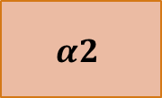
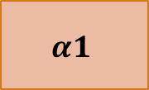
WHAT IS BAND GAP REFERENCE?
Principle
If two quantities having opposite temperature coefficients (TCs) are added with proper weighting, the result displays a zero TC
Generates Reference voltage independent of Temperature & VDD
Main building block of any IC
V
PTAT
$$α1$$
Vref
Vref
+
CTAT
$$α2$$
Reference Voltage, Temperature
$((α1 ∗PTAT)$ + $(α2 ∗CTAT)$ = CONSTANT VOLTAGE

Slide 6
PROPORTIONAL TO ABSOLUTE TEMP
(PTAT)
COMPLEMENTORY TO ABSOLUTE TEMP
(CTAT)
Vol
Vol
Temperature
Temperature
CONSTANT
I,V
PTAT
CTAT
Temperature

Slide 7
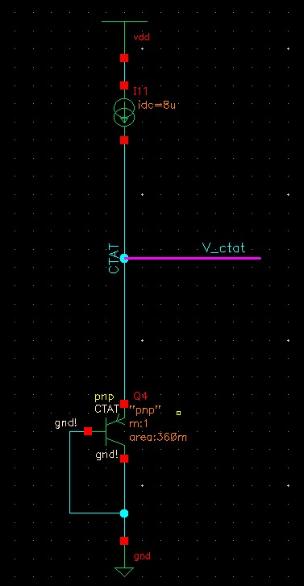
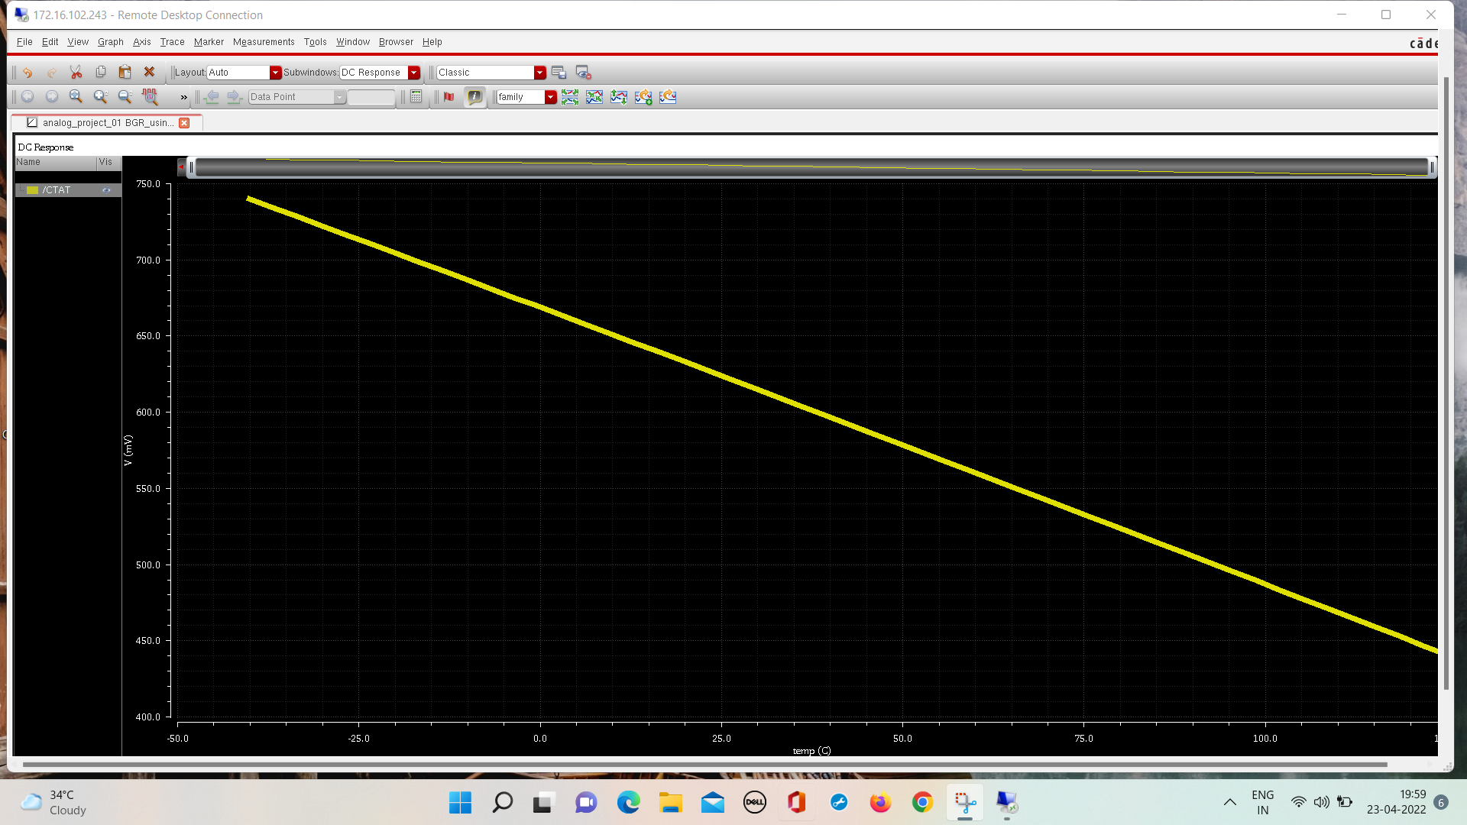

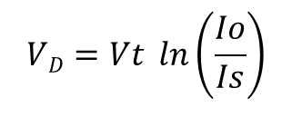



Complementary To Absolute Temperature (CTAT)
The base-emitter voltage of bipolar transistors or, more generally, the forward voltage of a p-n junction diode exhibits a negative TC.
$$VD=Vt \ln\left(\frac{Io}{Is}\right)$$
$$\frac{dVd}{dT}=−1.6mV/0K$$
$$ID=Is e^{\frac{VD}{VT}}$$
$$Is∝ μ\text{.}\text{k}\text{.}{T , ni}^{2}$$
$${ni}^{2}∝ T^{3} e^{kT}$$
$$Is∝ b {e^{\frac{−Eg}{kT}} T}^{4+m}$$
Fig: CTAT Curve
Fig: CTAT ckt

Slide 8
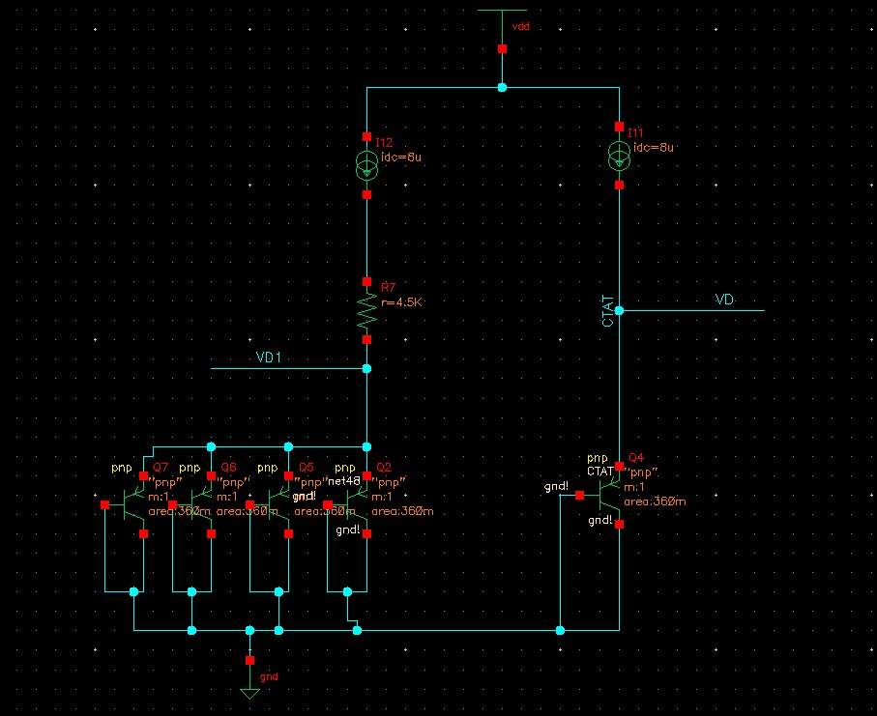
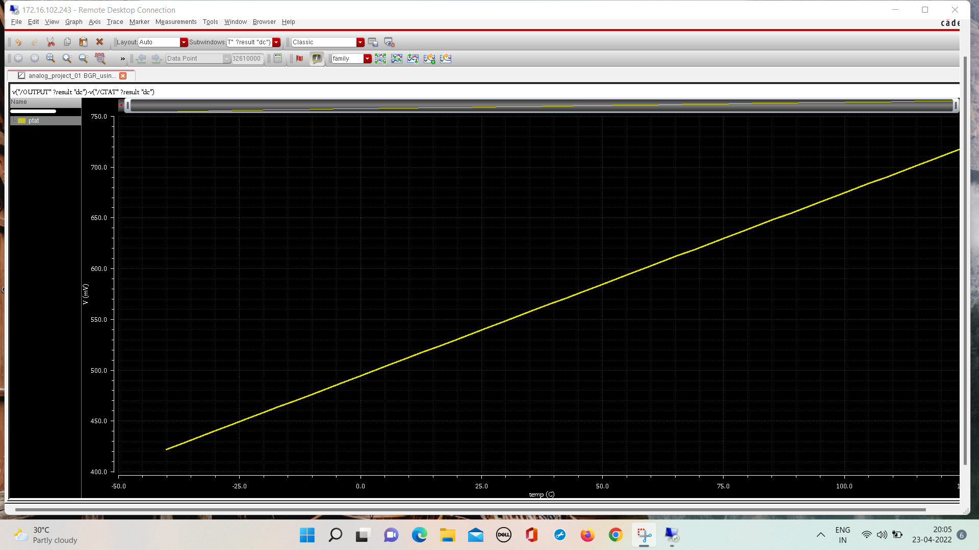



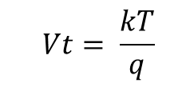

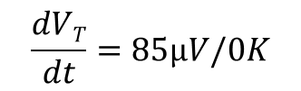
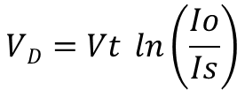

Proportional To Absolute Temperature (PTAT)
If two bipolar transistors operate at unequal current densities, then the difference between their base-emitter voltages is directly proportional to the absolute temperature.
$$Vt= \frac{kT}{q}$$
$$VD=Vt \ln\left(\frac{Io}{Is}\right)$$
V_{D1}=$Vt \ln\left(\frac{Io}{η Is}\right)$
$$\frac{dVT}{dt}=85µV/0K$$
$VD−VD1 = Vt ln{(n)}$
$$VD=VD2$$
$$VD2=ID R + VD$$
$$ID R=Vt ln{(n)}$$
Fig: PTAT Curve
Fig: PTAT ckt

Slide 9
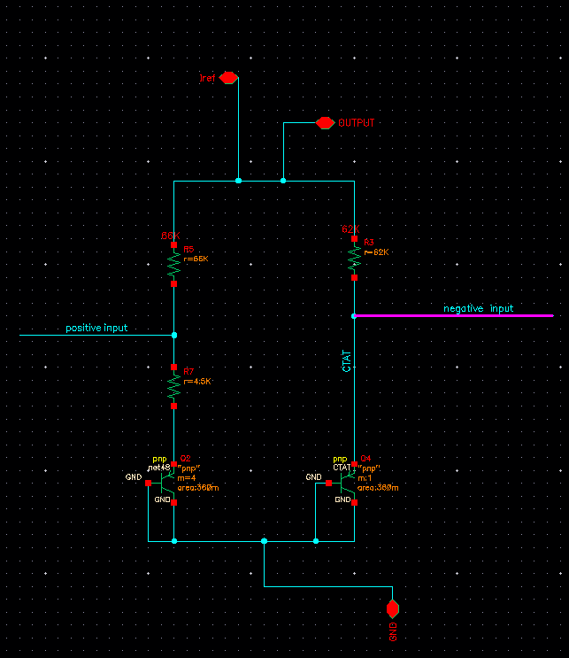
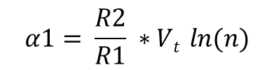
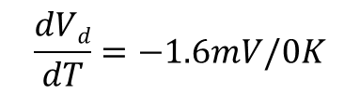


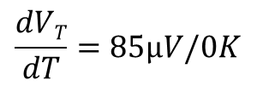
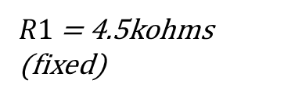






CIRCUIT OPERATION
CALCULATIONS FOR BANDGAPCORE CIRCUIT
$(α1 ∗PTAT)$ + $(α2 ∗CTAT)$ = CONSTANT VOLTAGE
$$\frac{dVT}{dT}=85µV/0K$$
$(α1 ∗\frac{dVT}{dT})$ + $(α2 ∗\frac{dVd}{dt})$ = 0
$$\frac{dVd}{dT}=−1.6mV/0K$$
$$α2 =1$$
$(α1 ∗85µV/0K)$ + $(−1.6mV/0K)$ = 0
$$α1=18.88$$
$$Io∗R1=VT ∗ln⁡(n)$$
$$α1= \frac{R2}{R1} ∗Vt ln{(n)}$$
$Io$ = 8uA
$$8uA∗R1=26mV ∗ln⁡(4)$$
R$2=$ 62K
$R1$ = 4.5kohms (fixed)
Fig: Bandgap core

Slide 10
BASIC STRUCTURE
START UP CIRCUIT
BANDGAP CORE
OPERATIONAL AMPLIFIER
Fig: basic block diagram of the design

Slide 11
BANDGAP CORE
No direct connection of the core with power supply
Core is driven by output of OP-AMP
As output voltage reaches a certain level , negative feedback at that point equals the positive feedback.
So, output can’t exceed that value.
Fig: Bandgap core

Slide 12
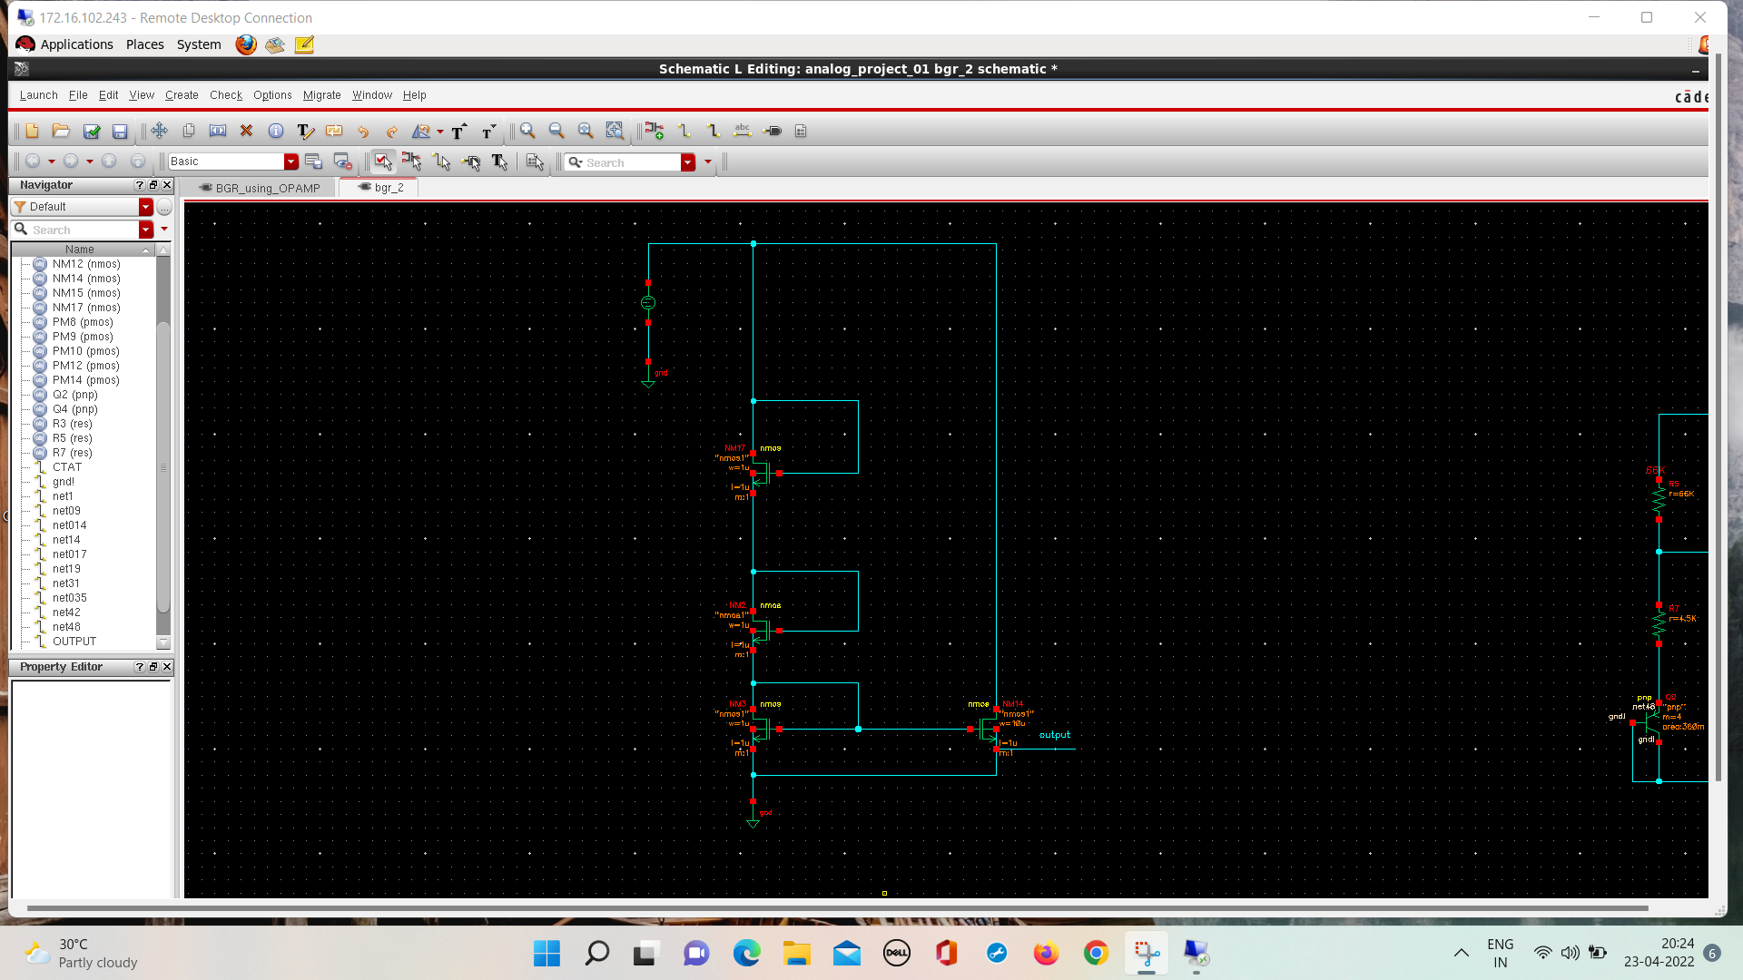
START UP CIRCUIT
Any self biased circuit should contain start-up circuit.
In bandgap core circuit, if all of the transistors carry zero current turning ON the supply, they may remain off indefinitely because the loop can support a zero current in both branches.
So, we need to inject current in the bandgap core for proper operation of the circuit. Start up circuit does this job
This circuit also turns off when steady state is reached.
Initially no current flows in bandgap circuit.
As circuit reaches steady state, source voltage of M4 becomes equal to reference voltage
As, three diode connected MOS are in series, gate voltage of M4 becomes sufficiently low, so that it turns off.
So the circuit has two regions of operation
1.zero current region (also a stable region).
2.Normal operating region.
Fig: Start-up ckt

Slide 13
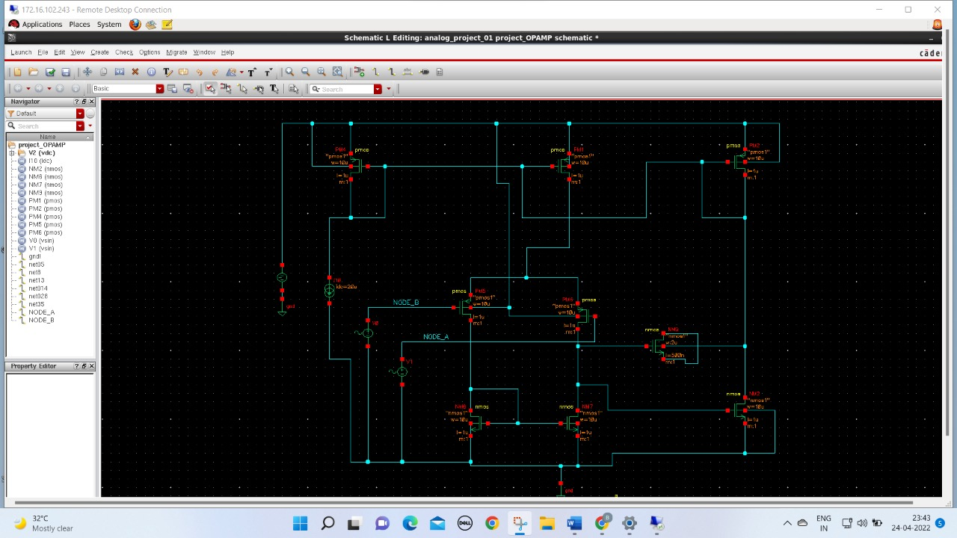
OPERATIONAL OP-AMP
It’s basically a two stage differential amplifier
Designed such that its output voltage is insensitive to supply variation
Main function is to drive the bandgap core with it’s Output current
Op-amp is being driven with its own output current to produce current insensitive to supply variation.
A two stage op-amp is used to increase the gain for proper functioning of Bandgap Core.
Transistors | Function
M1,M2 | differential pair
M3, M4 | Load
M7 | current source
M5,M8 | current mirror
M6 | common source amplifier
Fig: OP-AMP ckt

Slide 14
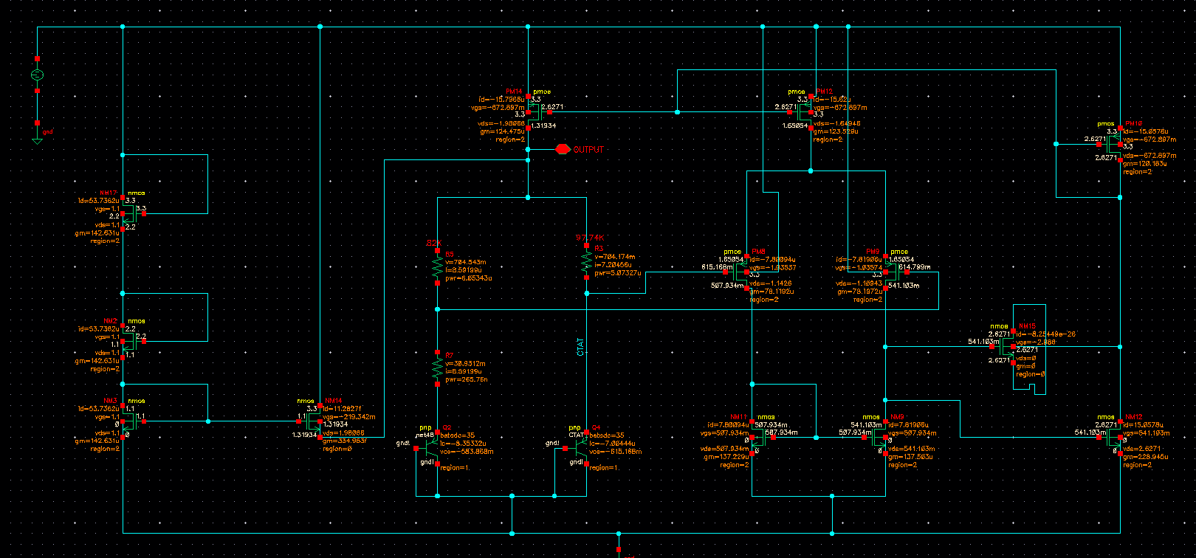
CIRCUIT SCHEMATIC
Fig: Complete Design Schematic

Slide 15
ANALYSIS OF SIMULATION RESULTS

Slide 16
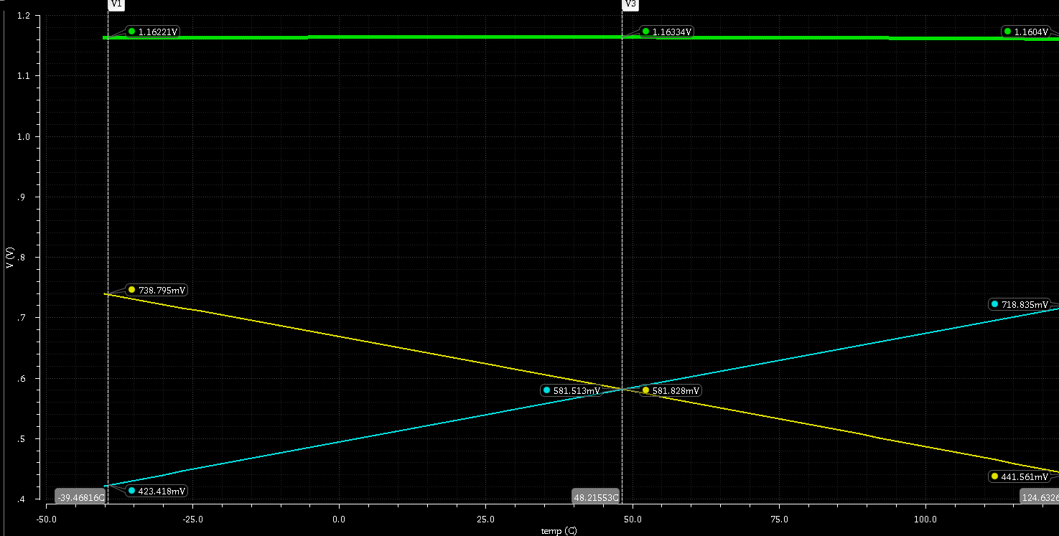
VARIATION OF REFERENCE VOLTAGE WITH RESPECT TO TEMPERATURE
Fig: PTAT, CTAT and Vref VS Temp Graph

Slide 17
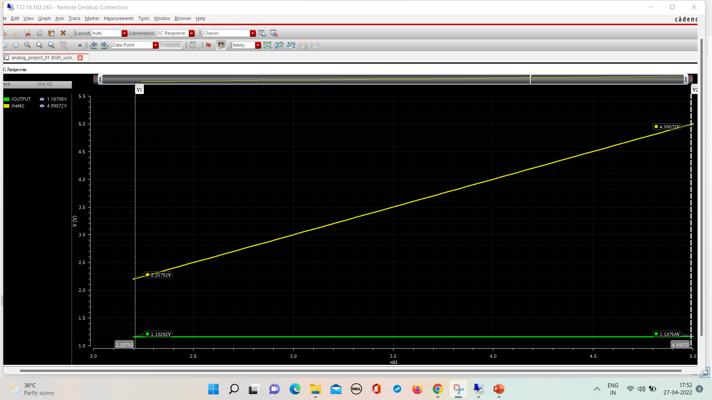
VARIATION OF REFERENCE VOLTAGE WITH RESPECT TO VDD
Fig: Vref VS temp
Supply voltage varies from to 2.2 to 5V and the respective Vref varies by 4.9mV which is very very less comparatively.

Slide 18
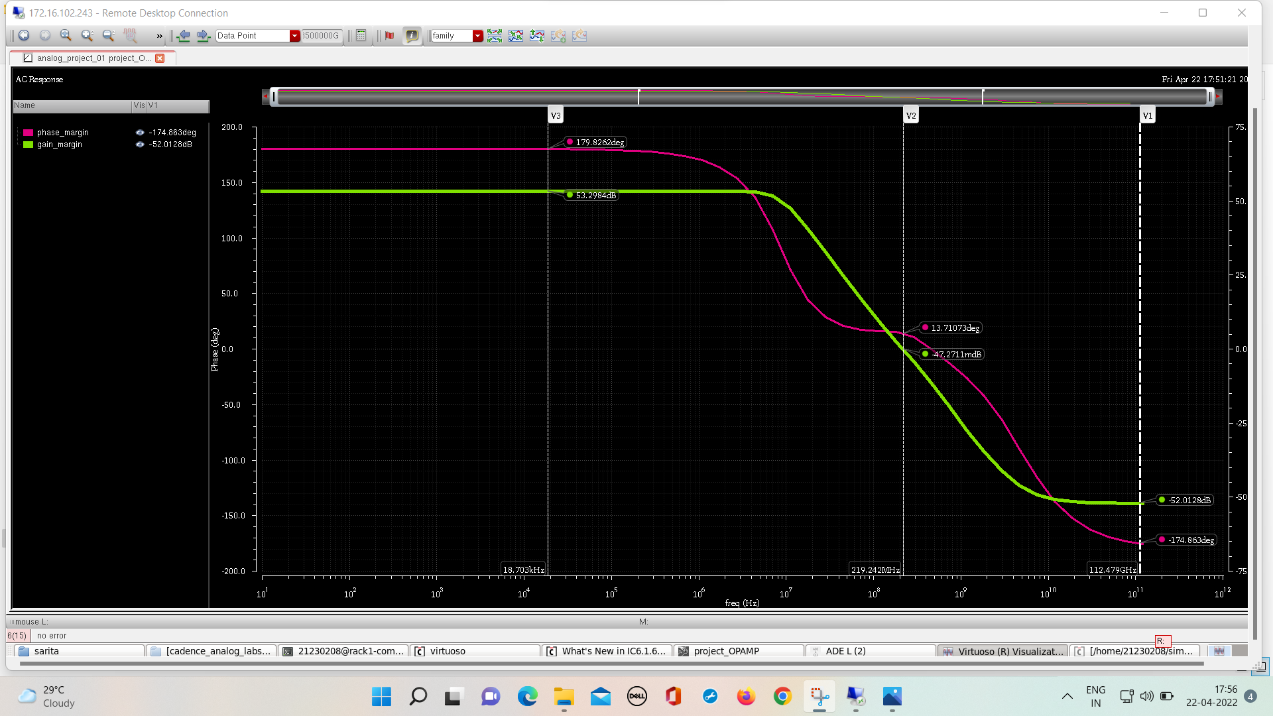
STABILITY ANALYSIS OF THE OP-AMP
Fig: Gain & Phase Vs freq graph

Slide 19
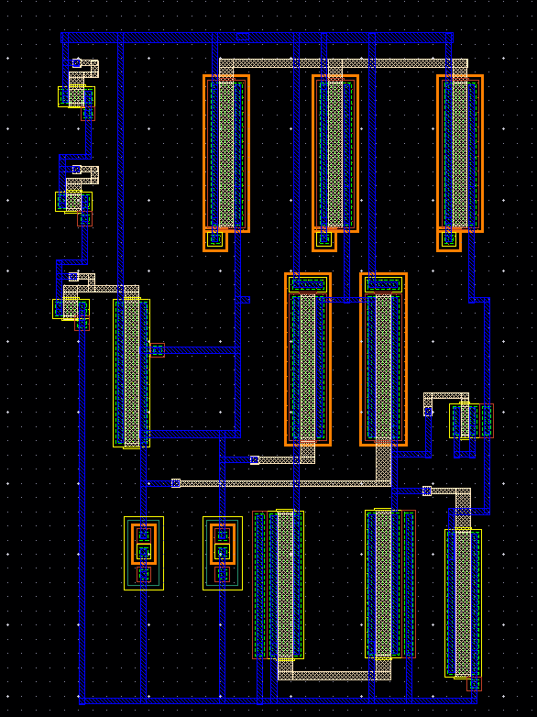
LAYOUT
Fig: Layout of the complete schematic

Slide 20
Applications of BGR
Used in LDO:
Linear and low-dropout (LDO) regulators are a simple, inexpensive way to provide a regulated output voltage that is powered from a higher voltage input in a variety of applications
2. Used in ADC:
In an analog-to-digital converter (ADC), the DC voltage reference together with the analog input signal is used to generate the digitized output signal.
3. Used in DAC:
In a digital-to-analog converter (DAC), the DAC selects and produces an analog output from the DC reference voltage according to the digital input signal presented at the input of the DAC

Slide 21
DISCUSSION
Problem faced during Implementation
What have we learnt from this project?
Initially transistors of the op-amp were coming in sub-threshold region.
To bring them into Saturation Region, we have changed the values of Resistances used in Band Gap Core.
Working of BGR
Complex Analog Circuit Designing
In-depth functionality of cadence tool
Complex layout designing
Importance of team-work

Slide 22
CONCLUSION
The BGR Voltage has been generated successfully using a 2 stage OPAMP by implementing the circuit in Cadence using 180nm technology node and performing the AC analysis.
The constant voltage of around 1.16V is obtained even when the Temperature was varied from -40⁰C to +125⁰C and VDD was varied from 2.2V to 5V.
The name Bandgap Reference is given to the ckt because output voltage of a typical bandgap reference is close to the theoretical band-gap voltage of silicon i.e. 1.205 V at 0⁰K

Slide 23
REFERENCES
https://www.researchgate.net/publication/331829678_Bandgap_Reference_Voltage_Generation_Using_a_Two-Stage_Operational_Amplifier

Slide 24
THANK YOU!

